Slide 1
Exploring Sephora Skincare Products and Reviews
Group 2
Sreeja Kodati, Qiu Yuan Huang, Preethi Natesan Sridhar

Slide 2

Project Description
Our team aims to conduct an in-depth analysis of Sephora’s skincare product offerings and customer reviews.
The dataset, sourced from Kaggle, comprises over 8,000 products and 1 million user reviews specifically from the skincare category.
By examining various dimensions such as product names, brands, ratings, prices, and availability, we intend to uncover valuable insights.
These insights will help us understand customer preferences, identify popular products, and potentially improve marketing strategies.
Throughout the semester, we have applied statistical techniques, data visualization, and natural language processing (NLP) to extract meaningful patterns and trends from this rich dataset .

Slide 3
1.
Exploratory Data Analysis
Data Cleaning
Perform the Exploratory Data Analysis

Slide 4
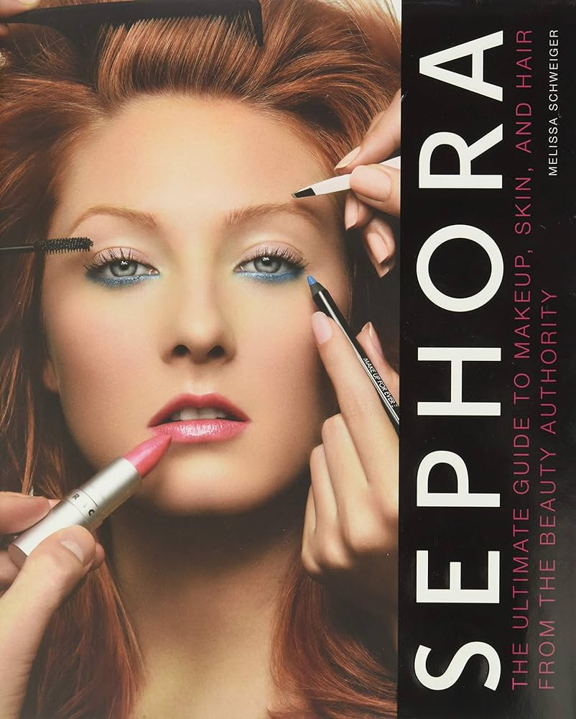
Description of the Data
Data Source:
The dataset was meticulously curated from Kaggle and specifically focuses on Sephora products and skin care reviews.
Data Collection Method:
The data was systematically collected from Sephora’s online platform. It encompasses information on over 8,000 products and more than 1 million user reviews within the skincare category.
Data Shape:
Product Data Content has 8494 rows and 27 columns.Reviews Data Content has 15 columns and over 1 million rows.

Slide 5
Purpose
Target
Missing Data
Inconsistent Data
Data Cleaning
Duplicate Data
Irrelevant Data
Outliers
Data Analysis Pipeline
A.Product Information Analysis
2. Exploratory Data Analysis
B.Sentiment Analysis of Reviews
C.Rating Trend Analysis

Slide 6
We encountered missing values in several columns, which could potentially skew our analysis and lead to incorrect conclusions.
Missing Data
We standardized the data to ensure uniformity, which is crucial for accurate categorization and analysis.
Inconsistent Data
Data Cleaning
Duplicate entries can distort data analysis by over-representing certain observations. We removed these duplicates to prevent bias.
Duplicate Data
Removing these helped simplify the dataset and focus on the variables that matter most to our study.
Irrelevant Data
We used the Interquartile Range (IQR) method to identify and remove extreme values from the price_usd column.
Outliers

Slide 7
2. Exploratory Data Analysis
A.Product Information Analysis
B.Sentiment Analysis of Reviews
C.Rating Trend Analysis
We analyzed the distribution of products across different categories, their price range, and ratings to understand the market segmentation better.
Utilizing the TextBlob library, we performed sentiment analysis on customer reviews to gauge overall sentiment trends and customer satisfaction levels.
We explored how product ratings evolved over time to identify any trends in customer satisfaction.

Slide 8
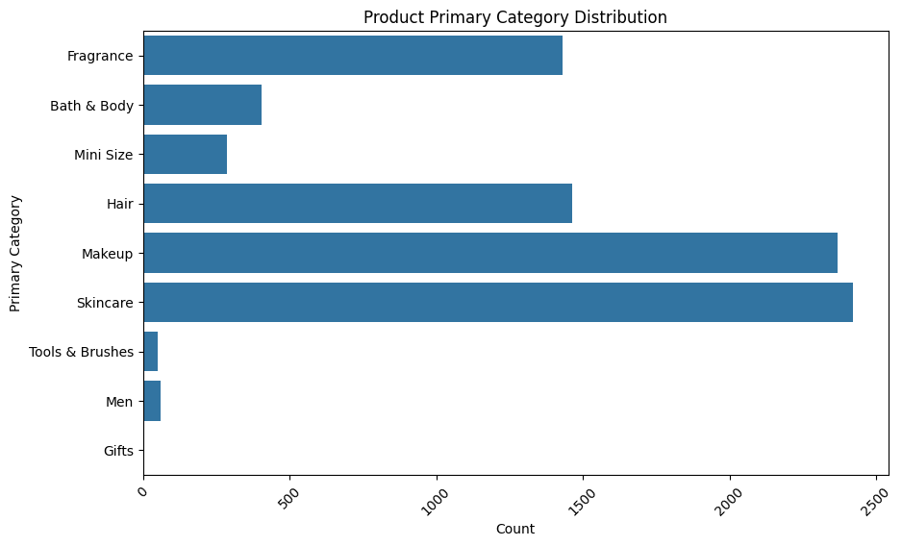
2. Exploratory Data Analysis
A.Product Information Analysis
Through visualizing the product category distribution, we observed a concentration of products in a few categories, indicating potential market saturation or popular segments.
Price distribution analysis highlighted a wide range of products catering to both budget-friendly and premium segments.
The average ratings across different categories revealed high customer satisfaction in niche categories, suggesting quality or specialized offerings in these areas.

Slide 9
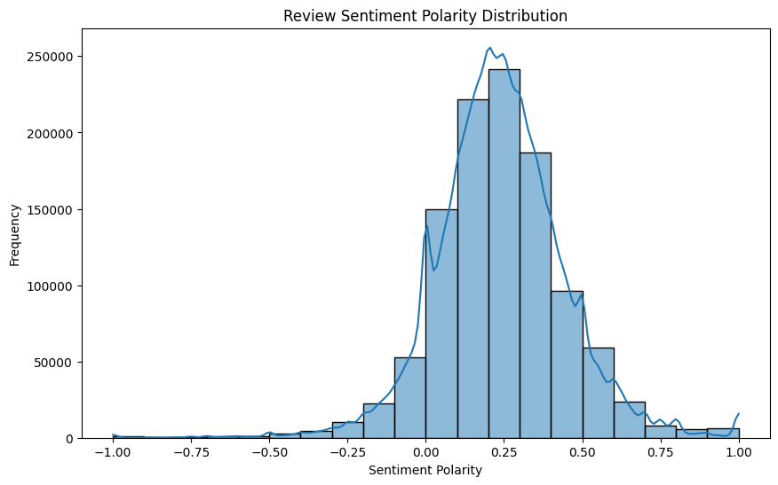
2. Exploratory Data Analysis
B.Sentiment Analysis of Reviews
The sentiment analysis indicated a predominantly positive sentiment among the reviews, with a significant portion of reviews reflecting high customer satisfaction.
Visualizing sentiment polarity scores revealed a skew towards positive ratings, emphasizing the quality of products or customer service.
However, the presence of negative sentiments in some reviews underscored areas for improvement, particularly in product effectiveness or expectations.

Slide 10
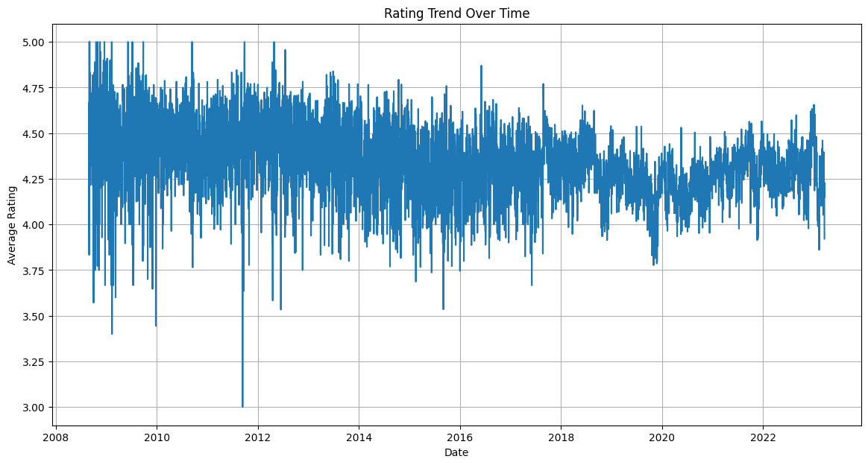
2. Exploratory Data Analysis
C.Rating Trend Analysis
Analyzing the trend of product ratings over time, we observed fluctuations that corresponded with product launches, marketing campaigns, or seasonal shopping periods.
This analysis underscored the impact of external factors on customer perceptions and satisfaction levels.
A steady increase in average ratings for certain products over time suggested successful improvements or growing customer appreciation.

Slide 11
Prediction Questions
What are the top-reviewed companies based on reviews?
Analyze review texts using sentiment analysis to identify companies with the highest sentiment scores, indicating customer satisfaction.
Can product popularity be predicted based on attributes?
Predicting the popularity of Sephora products based on various attributes, such as brand, price, size, and category.
What are the patterns in customer feedback and preferences ?
Use text clustering techniques to group products based on similarities in review texts

Slide 12
2.
Prediction Question 1
What are the top-reviewed companies based on reviews?

Slide 13
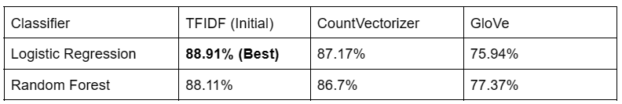
Prediction Question 1
What are the top-reviewed products?
Undertook the task of sentiment analysis on Sephora product reviews.
Reviews with ratings above three were categorized as ‘positive’, while those with reviews of three or below three were labeled negative.
Evaluated the performance of classifiers using TFIDF, CountVectorizer and GloVe embeddings with Logistic Regression and Random Forest algorithms.

Slide 14
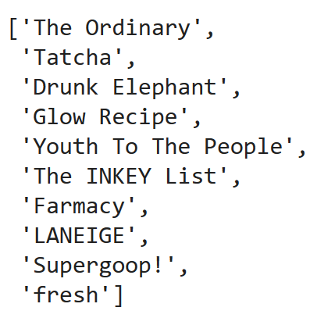
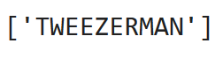
Prediction Question 1
Top performing companies
Identified top-performing companies based on sentiment scores, reflecting their brand popularity.
Discovered only one company with a negative sentiment score, attributed to low review count and newness in the market.
Noted overall low review counts for many brands, raising concerns about result generalization due to insufficient data.

Slide 15
2.
Prediction Question 2
Can product popularity be predicted based on attributes?

Slide 16
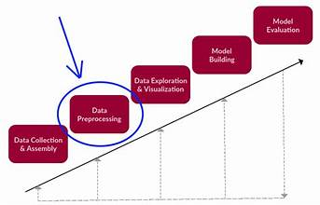
Prediction Question 2
Can product popularity be predicted based on attributes?
Methodology:
Step 1:Data Loading and Preprocessing:
The dataset is loaded, and relevant features such as 'rating', 'is_recommended', 'total_feedback_count', 'sentiment', and others are selected for analysis.
Textual features ('review_text', 'review_title') are processed for sentiment analysis and topic modeling, while categorical variables are one-hot encoded for model compatibility.

Slide 17
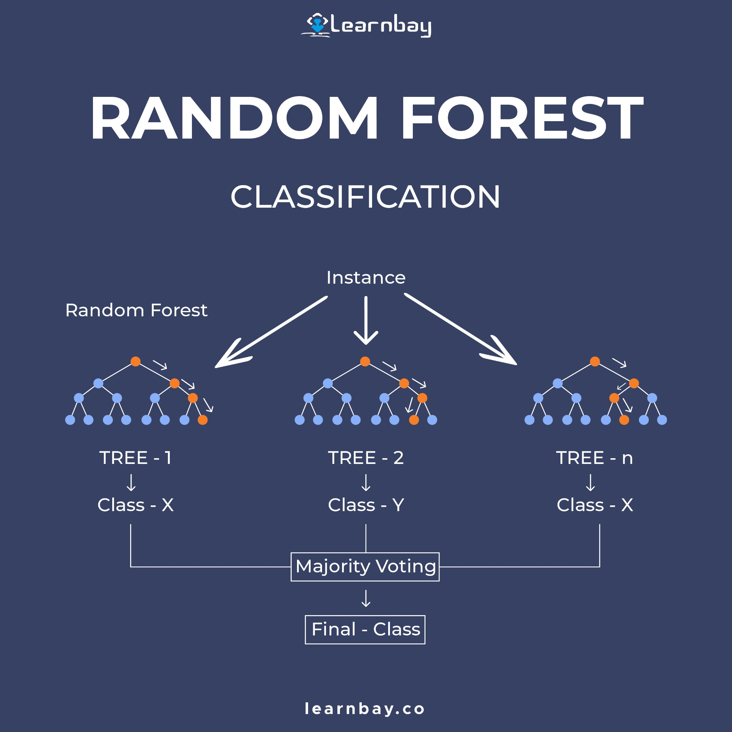
Prediction Question 2
Can product popularity be predicted based on attributes?
Methodology:
Step 2: Model Training
A Random forest Regressor model is initialized and trained using the preprocessed data.
This model is chosen for its ability to handle both numerical and categorical features and its effectiveness in regression tasks.

Slide 18
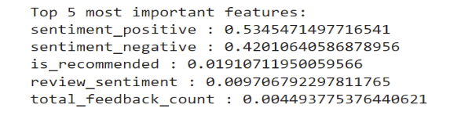
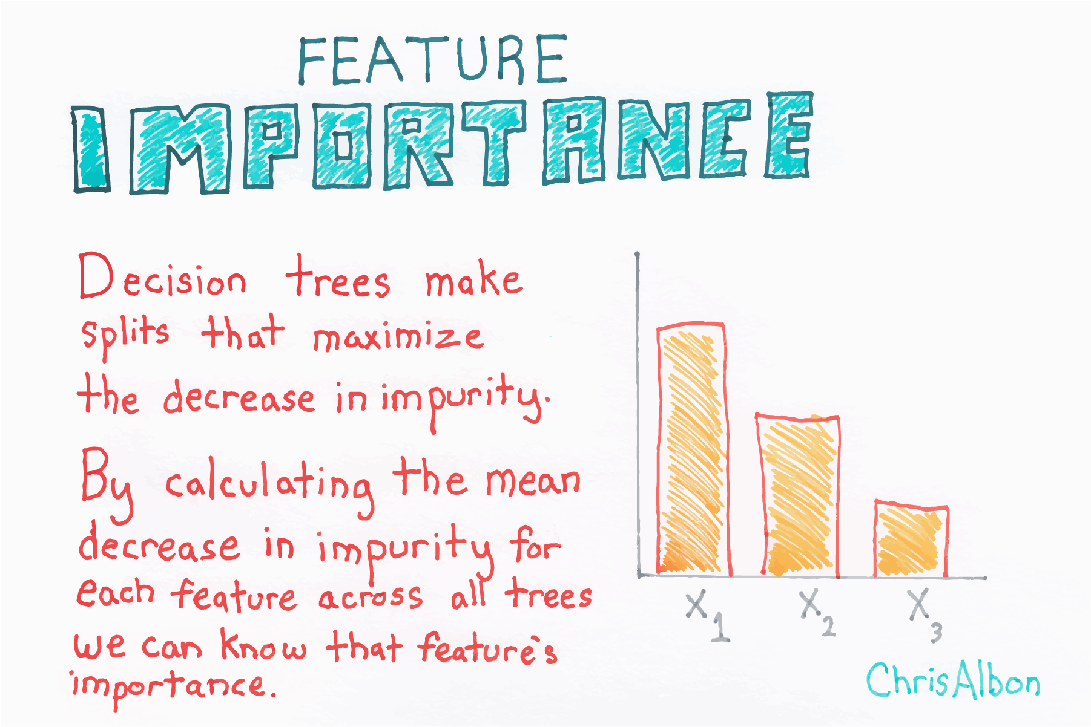
Prediction Question 2
Can product popularity be predicted based on attributes?
Methodology:
Step 3: Feature Importance Analysis: The feature importances of the trained model are examined to understand the relative importance of each attribute in predicting product ratings. This analysis helps identify the key drivers of product popularity.
The feature importance score as below:
is_recommended: 0.019107
helpfulness: 0.001702
total_feedback_count: 0.004494
sentiment_positive: 0.534547
sentiment_negative: 0.420106
total_neg_feedback_count: 0.001164
total_pos_feedback_count: 0.000680
price_usd: 0.000107
review_sentiment: 0.009707
topic: 0.003018

Slide 19
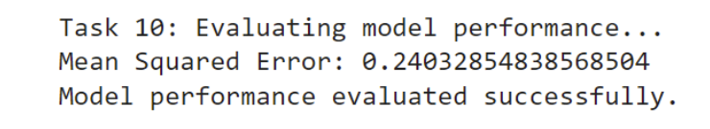
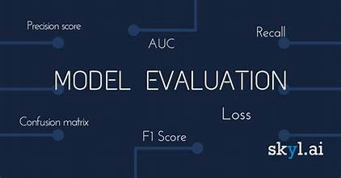
Prediction Question 2
Can product popularity be predicted based on attributes?
Methodology:
Step 4: Model Evaluation
The trained model's performance is evaluated using the mean squared error (MSE) metric.
The model's performance evaluation reveals a remarkably low Mean Squared Error (MSE) of 0.2403.
This result suggests that the model's predictions closely align with the actual ratings, indicating a highly effective performance.
With such a low MSE, we can confidently assert that the model's ability to predict product popularity based on attributes is notably accurate, showcasing its potential for real-world applications.

Slide 20

Prediction Question 2
Can product popularity be predicted based on attributes?
Methodology:
Step 5: Results
The analysis reveals several key findings:
Sentiment-related features, particularly positive sentiment, and negative sentiment, are identified as the most influential factors in predicting product ratings.
Other important features include 'is_recommended', 'total_feedback_count', and 'review_sentiment', indicating the significance of customer feedback and recommendations in determining product popularity.
The evaluated model demonstrates reasonable performance in predicting ratings, as indicated by the obtained MSE value.

Slide 21
3.
Bonus Question and Exploration
Incorporating Named Entity Recognition (NER) into the project

Slide 22
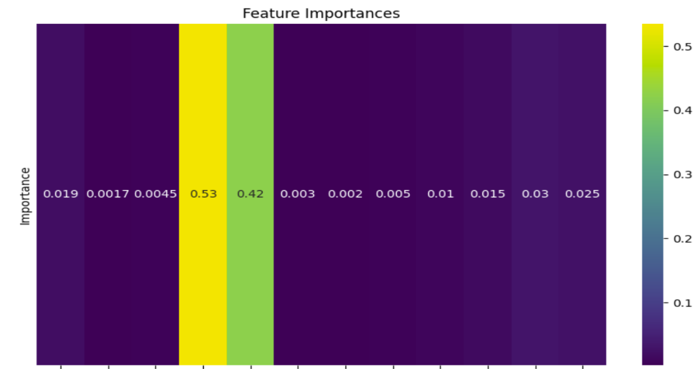
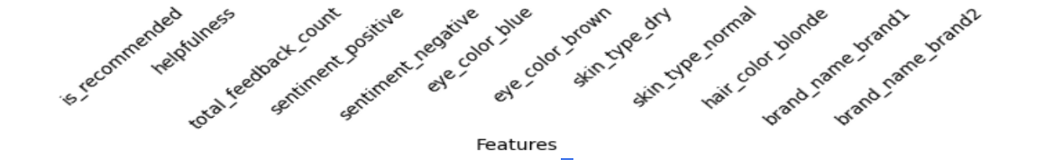
Prediction Question 2
Can product popularity be predicted based on attributes?
Methodology:
Step 6: Conclusion
By leveraging customer feedback and sentiment analysis, businesses can gain valuable insights into consumer preferences and behaviors, leading to more informed decision-making and improved product outcomes.

Slide 23


Named Entity Recognition.
Named Entity Recognition (NER) is a natural language processing (NLP) technique used to identify and classify named entities within unstructured text.
These entities can include various types of proper nouns such as names of people, organizations, locations, dates, quantities, and more.
The primary objective of NER is to automatically extract and categorize these entities to provide a structured understanding of the text.

Slide 24
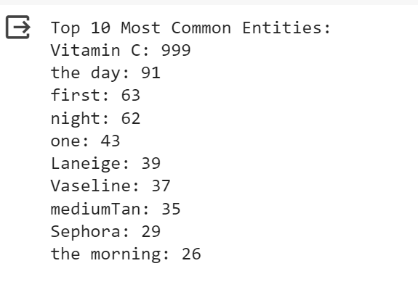
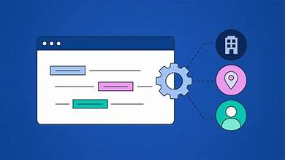
Named Entity Recognition.
WHY:
Automatically extract named entities such as brand names, ingredient names, and product categories
Helps in organizing and categorizing the textual data more effectively.
Questions solved:
Question 1:What are the most frequently mentioned entities in the reviews?

Slide 25
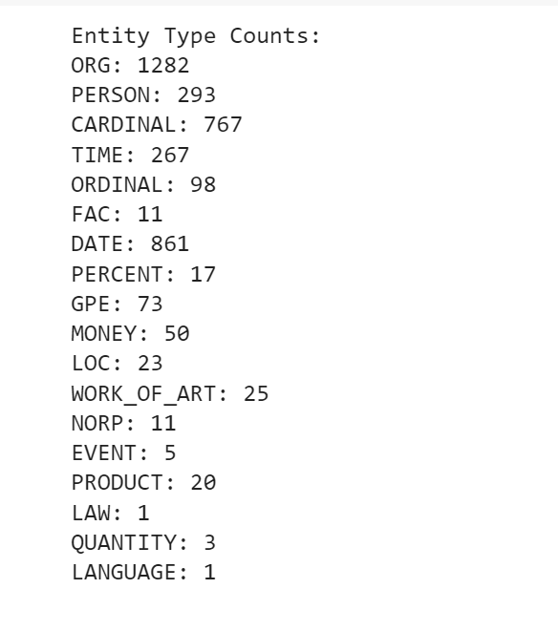
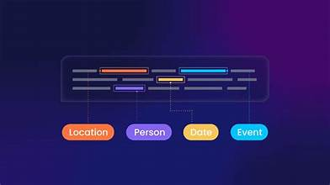
Named Entity Recognition.
Questions solved:
Question 2:What are the different types of entities mentioned in the reviews?
Question 3:How many entities of each type are mentioned in the reviews?

Slide 26
4.
Prediction Question 3
What are the patterns in customer feedback and preferences?

Slide 27
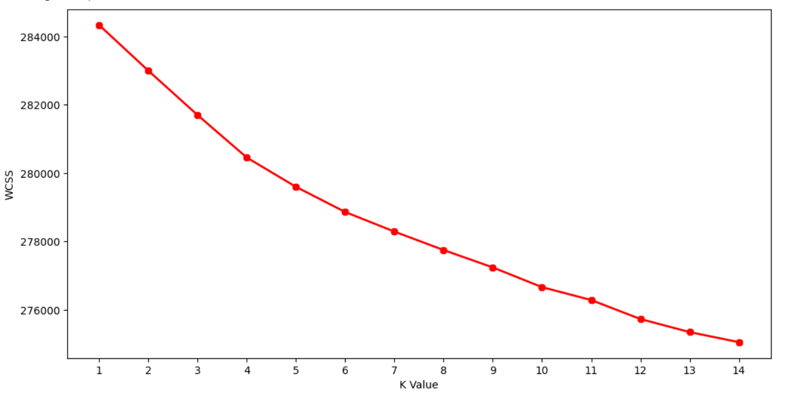
Prediction Question 3
What are the patterns in customer feedback and preferences?
Utilized K-Means clustering algorithm to uncover potential clusters within reviews based on textual context.
Initially, experimented with k=2 clusters to explore sentiment or content distinctions, then iteratively tested with various k values.
Found optimal clustering results with k=4 clusters.

Slide 28
Cluster Analysis Results
Cluster 0: Lip Care
Focuses on lip care products like balms and masks.
Cluster 1: Skincare
Discusses a range of skincare products for the face.
Cluster 2: Eye Care
Specific to eye care products, particularly creams for dark circles and lines.
Cluster 3: Moisturizing Skincare Products
Concentrates on moisturizing skincare products for the face.
Essentially, these clusters highlight the diversity of products and concerns within the Sephora dataset. Customers have varied preferences and priorities when it comes to beauty products and routines. These clusters provide insights in understanding customer preferences overall.

Slide 29
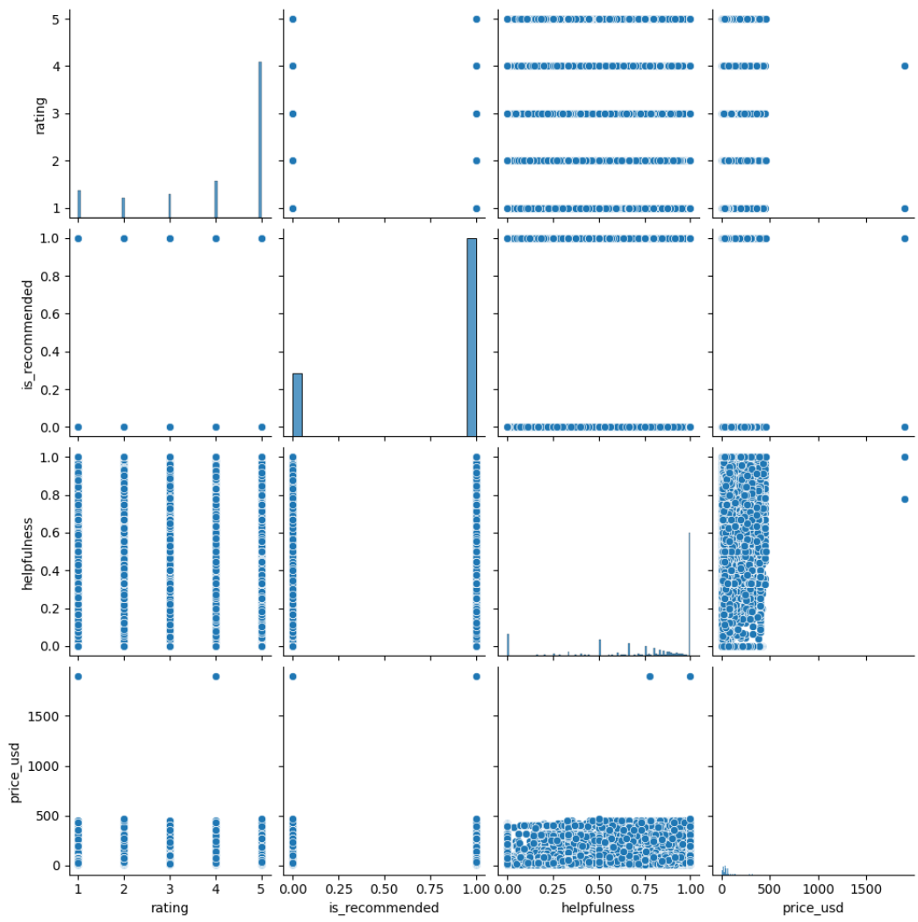
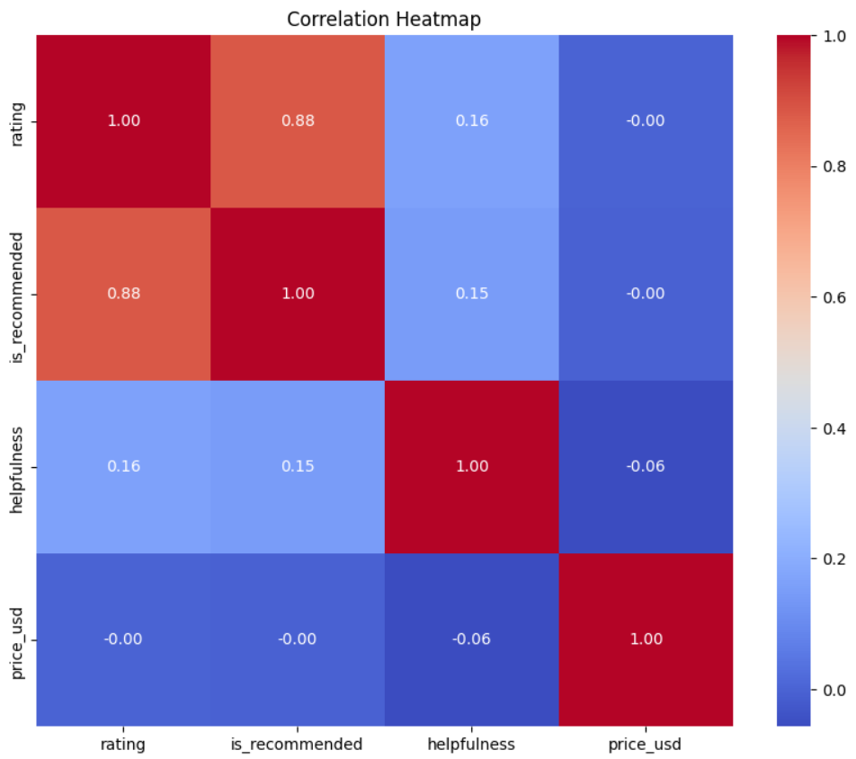
Visualizing numerical features
Pair plot of all the numerical features
Correlation matrix results

Slide 30
Visualizing numerical features
Pair plot visualization and correlation matrix yielded unsatisfactory results.
Noteworthy Patterns Identified:
Higher ratings correlate with product recommendation, indicating a positive relationship.
Higher-rated reviews may be perceived as more helpful, though correlation is not strong.
Reviews marked as recommended may slightly correlate with perceived helpfulness.
Weak negative correlation between "is_recommended" and "price_usd," indicating almost no linear relationship.
Slight tendency for more helpful reviews was associated with lower-priced products, explaining the weak correlation.
Strongest correlation exists between "rating" and "is_recommended," suggesting that these two features may have more potential for clustering customers based on their reviews.

Slide 31
5.
Presenting Results
A customized chatbot that can answer questions regarding the project.

Slide 32
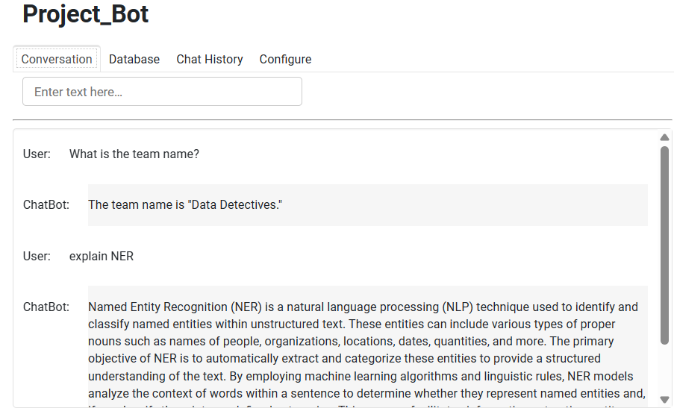
Training chatbot on the milestone documents
Developed an interactive and customized FAQ retrieval chatbot interface utilizing the ChatGPT API, LangChain, and VectorDB to answer user questions about the project.
Trained on all the milestone documents that were submitted as part of the project guidelines.

Slide 33
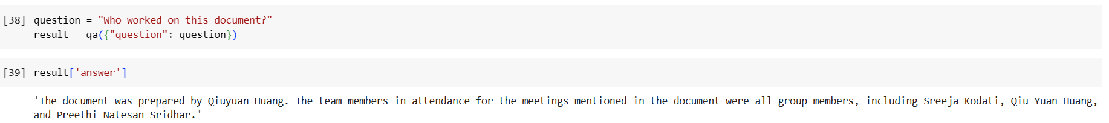
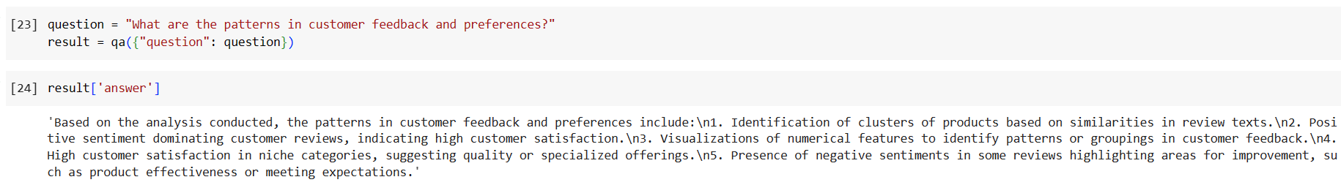
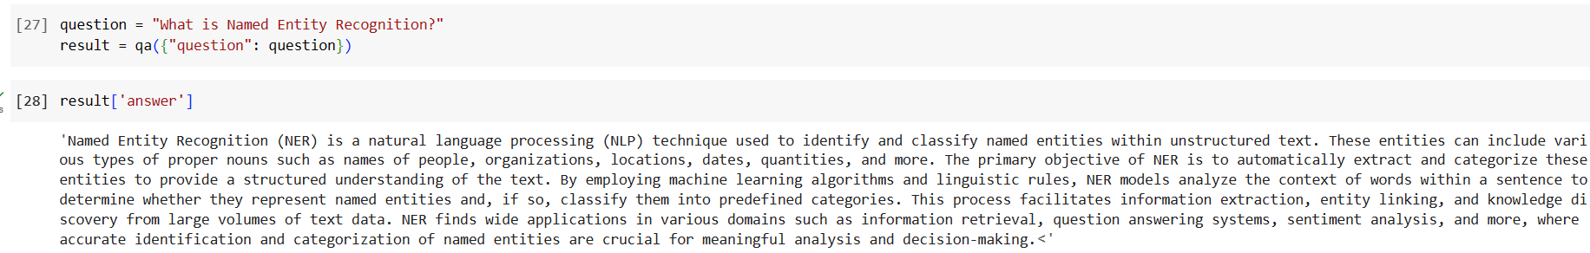
Training chatbot on the milestone documents

Slide 34

Training chatbot on the milestone documents

Slide 35
Thank You!

